Slide 1


EoMT forwarding
2025년 7월 23일
Suhyeon Lee
Department of Computer Engineering

Slide 2
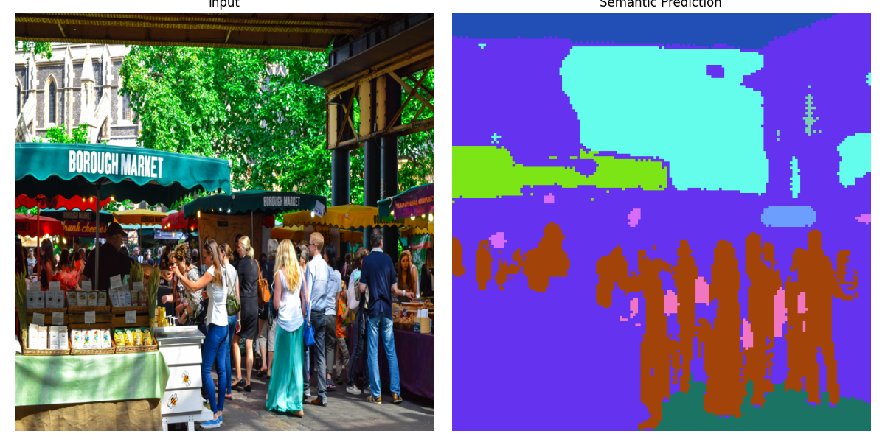
Model
모델명: eomt_small_640_2x (resolution:640, epoch 2배)
파라미터 수: 24.0M
랜덤 이미지 inference 결과

Slide 3
EoMT forward pass
 | 입력 shape | 출력 shape
Input | — | (1, 3, 640, 640)
Patch Embedding | (1, 3, 640, 640) | (1, 1600, 384)
Positional Embedding | (1, 1600, 384) | (1, 1605, 384) | CLS 등 5개 토큰 추가
Encoder Blocks 1–8 | (1, 1605, 384) | (1, 1605, 384)
Mask-Token 추가 | (1, 1605, 384) | (1, 1805, 384) | Mask 토큰 200개 추가
Encoder Blocks 9–11 | (1, 1805, 384) | (1, 1805, 384) | Masked Cross-Attention
Split Tokens | (1, 1805, 384) | Pixel: (1, 1605, 384) Mask: (1, 200, 384)
└ Class Head | (1, 200, 384) | (1, 200, 135) | 134 classes + 1 no-object
└ Mask Head | (1, 200, 384) | (1, 200, 160, 160) | pixel 해상도 (40×40) → mask 해상도 (160×160)

Slide 4
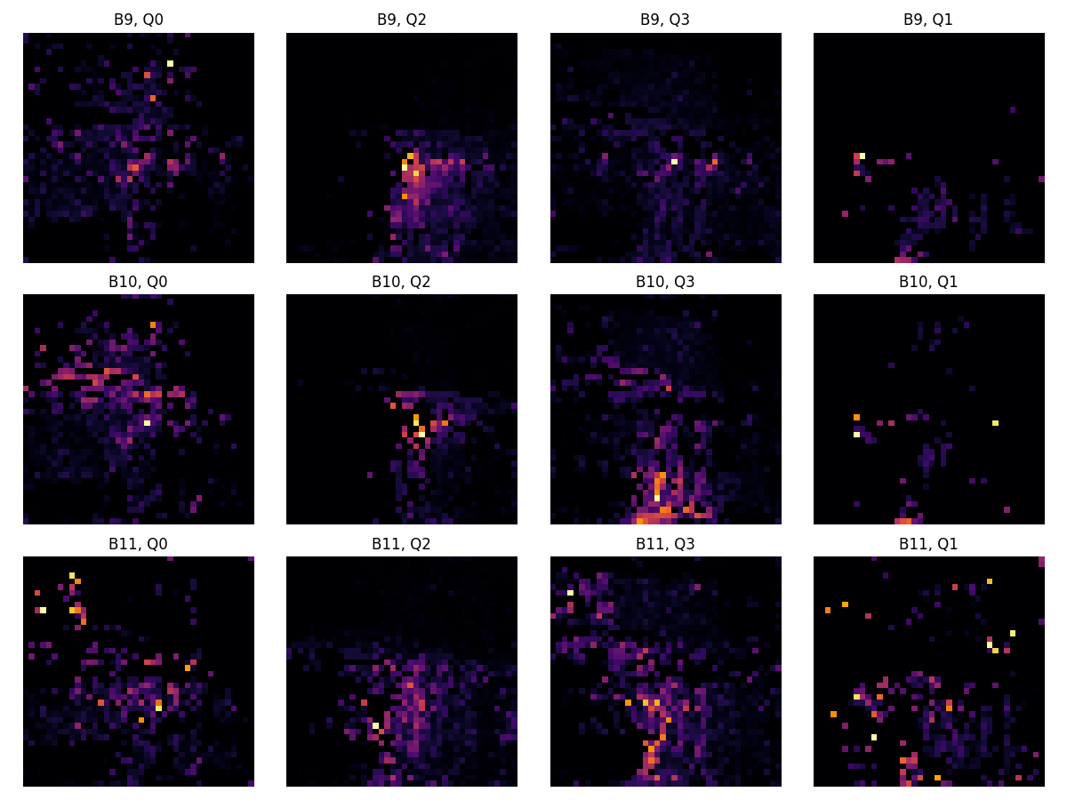
Masked Attention
Block i, top 4 query

Slide 5
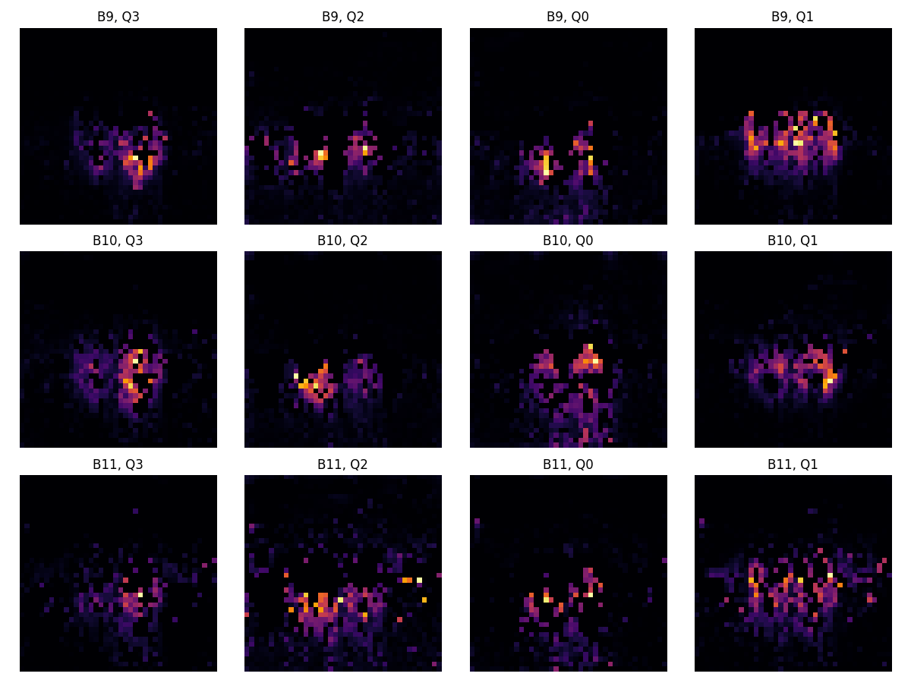

Masked Attention
Block i, top 4 query

Slide 6


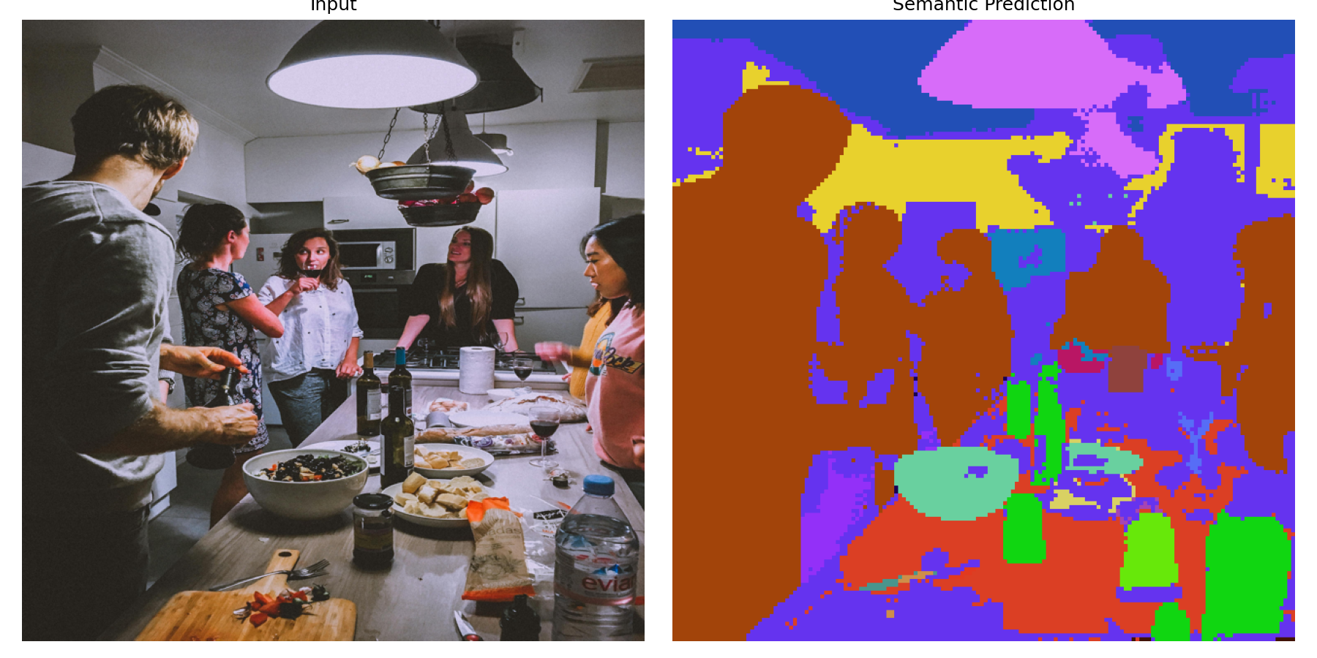
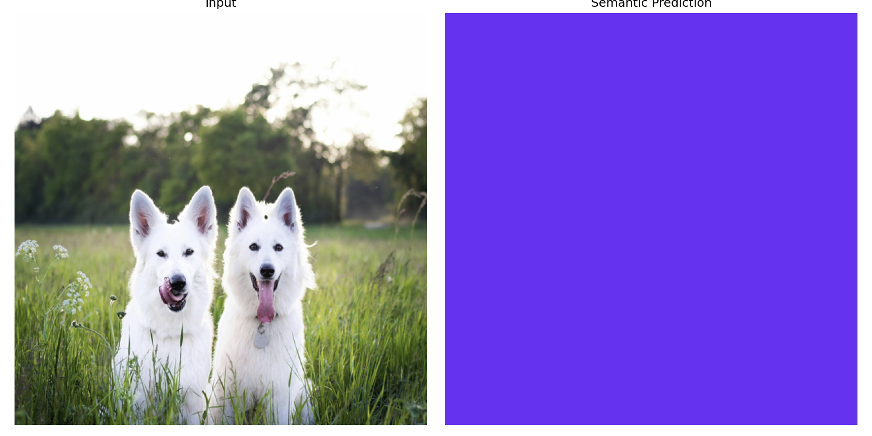
Inference 결과

